Slide 1



Multimodal Deception Detection System
Ain-Shams University
Faculty of Computer & Information Sciences
Team members:
Doaa Yehia
Rodayna Mohamed
Reem Ayman
Mena Ashraf
Medhat Essam
Mohamed Moawad
Department:
Computer Science
Supervisors:
Dr.Salsabil Amin
TA.Zeina Rayan

Slide 2

Agenda
Introduction
Applications
Related work
Objective
Architecture
Time plan
Challenges
Tools
References

Slide 3
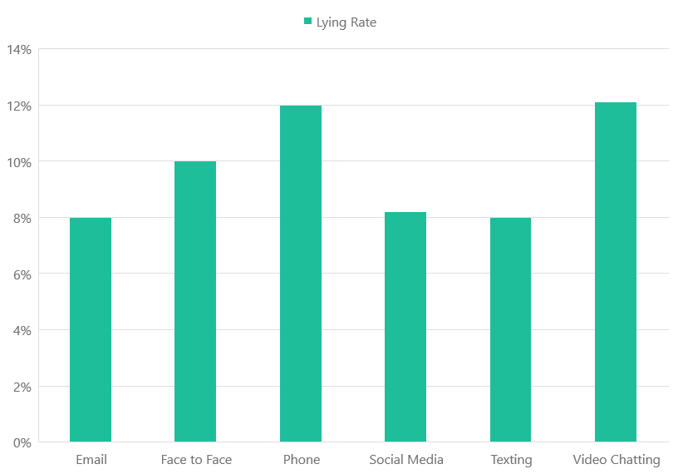
Introduction
Given the prevalence of deceit, the domain of lie detection gathers significant research attention and it is in continuous evolution every day.
On Average, a person tells 2-4 lies a day.
This chart shows the rate of lying across different forms of communication.

Slide 4
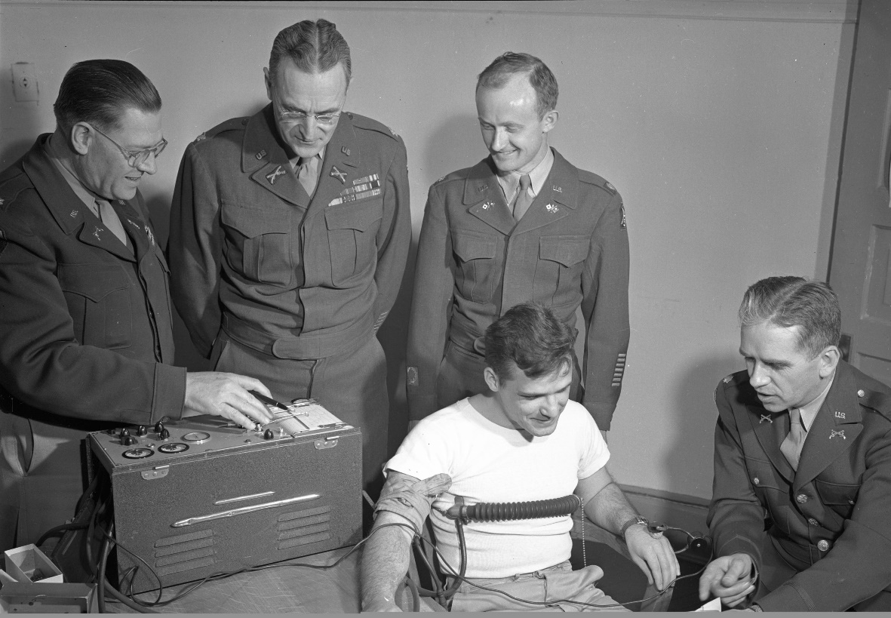
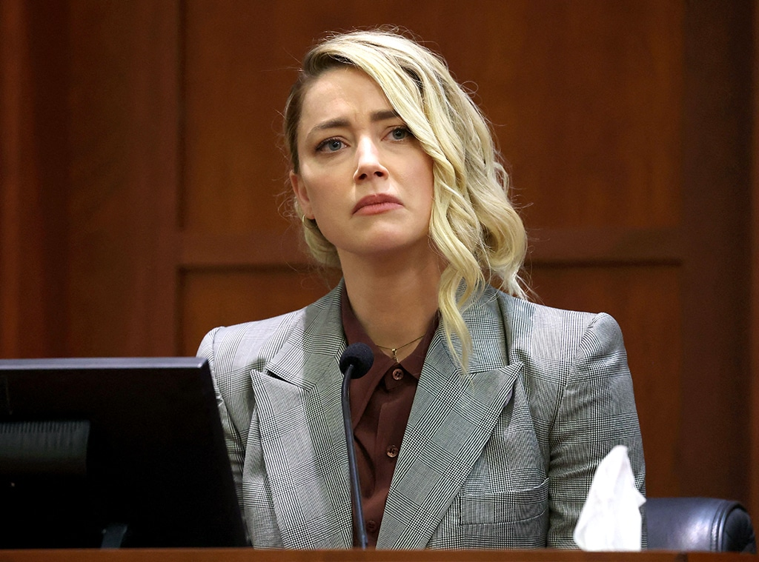
System Applications :
Military Purposes
Lawsuits

Slide 5
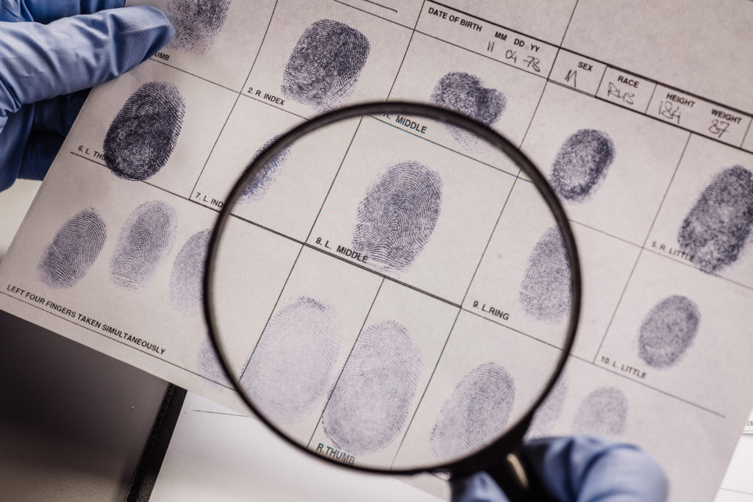
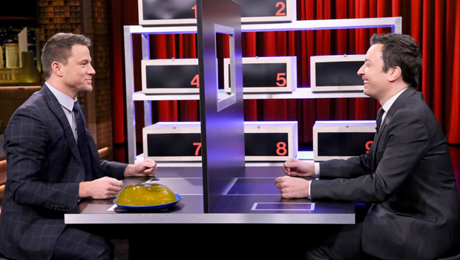
System Applications :
Criminology
Entertainment

Slide 6
Related Work
Authors | Dataset | Algorithm | Accuracy & metrics
A Gallardo-Antolín, JM Montero | Bag-of-Lies Dataset. | LSTM Networks. | 70%
F Soldner, V Pérez-Rosas, R Mihalcea | Dataset collected from Jimmy Fallon’s Box of Lies show. | Combining multiple verbal, non-verbal, and dialogue feature sets. | 69%
V Gupta, M Agarwal, M Arora, T Chakraborty, R Singh, M Vatsa | Bag-of-Lies Dataset. | Utilizing Gaze, Audio, Video and EEG Data using SVM, MLP, CNN and KNN to achieve a multimodal data fusion. | 66%
A Khaled, G Walaa, M Medhat, R Alaa, T Ehab | Real-life Trial Deception Detection Dataset. | 3D-CNN. | 80%
R Rill-García, H Jair Escalante, L Villasenor-Pineda, V Reyes-Meza | Real-life Trial Deception Detection Dataset. | Hierarchal BSSD and SVM. | 67.5%

Slide 7
Related Work (cont.)
Bareeda, EP Fathima, BS Shajee Mohan, and KV Ahammed Muneer | Real-life Trial Deception Detection Dataset. | MFCCs and SVMs | 81%
A Ni, A Azarang, N Kehtarnavaz | The UBFC Database. | 3D-CNN and CNN-LSTM. | 4.76 MSE (in BPM)
GH Martinez-Delgado, AJ Correa-Balan, JA May-Chan, CE Parra-Elizondo… | Manually generated dataset that contains 720p 30fps videos of subject’s faces while having their heart rate measured. | Eulerian Video Magnification Algorithm and MATLAB. | 0.8 ME (in BPM)
Z Yu, W Peng, X Li, X Hong, G Zhao | OBF and MAHNOB-HCI Datasets. | STVEN and rPPGNet . | 5.93 RMSE (in BPM)
Q Zhan, W Wang, G de Haan | HNU and PURE Datasets. | CNN. | ~ 0-2 RMSE (in BPM) And ~ 100% Accuracy on RGB videos except for some outliers.

Slide 8

Objective
We aim in this project to create a Multimodal deception detection website that integrates information from multiple modalities such as verbal, nonverbal, physiological, and contextual cues to detect deception.

Slide 9

System Architecture Diagram

Slide 10
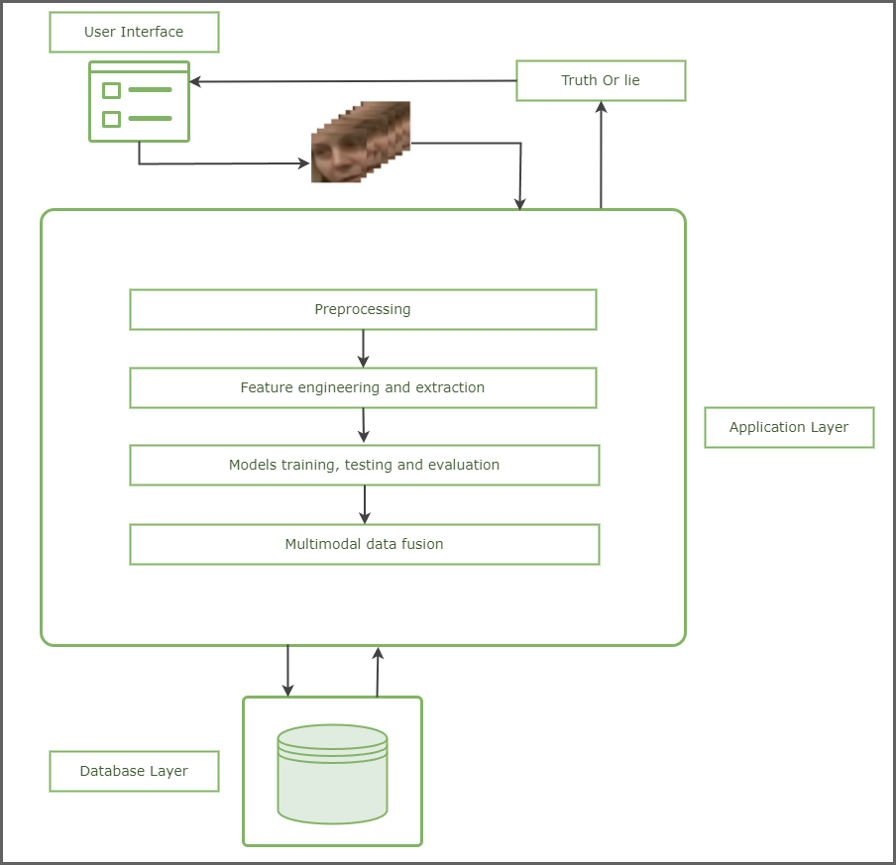

Slide 11

Datasets

Slide 12
Real-life Trial Deception Detection Dataset
The dataset was released in 2015.
It comprises a collection of 121 real-life courtroom trial videos. This includes 60 videos featuring truthful testimonies and 61 featuring deceptive ones.
Accompanying the dataset, there are annotations detailing various gestures and behavioral indicators observed within the videos.

Slide 13
Miami University Deception Detection Database (MU3D)
The dataset was released in 2017.
MU3D is a free resource containing 320 videos of Black and White targets, female and male, telling truths and lies. Eighty (20 Black female, 20 Black male, 20 White female, and 20 White male). Each target generated four different videos (i.e., positive truth, negative truth, positive lie, negative lie)
This database is accompanied by an excel codebook which includes data pertinent to the videos and targets included in the database.

Slide 14

Phases Description

Slide 15
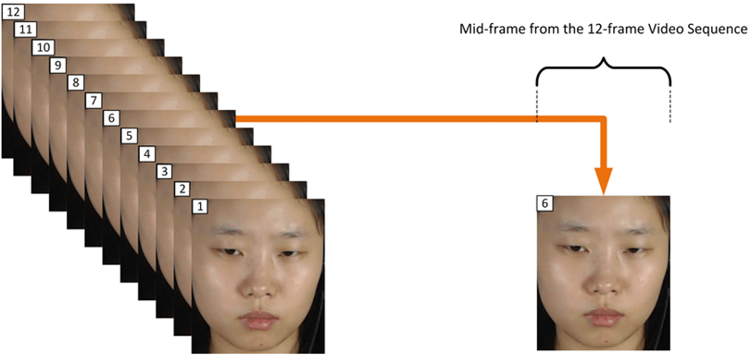
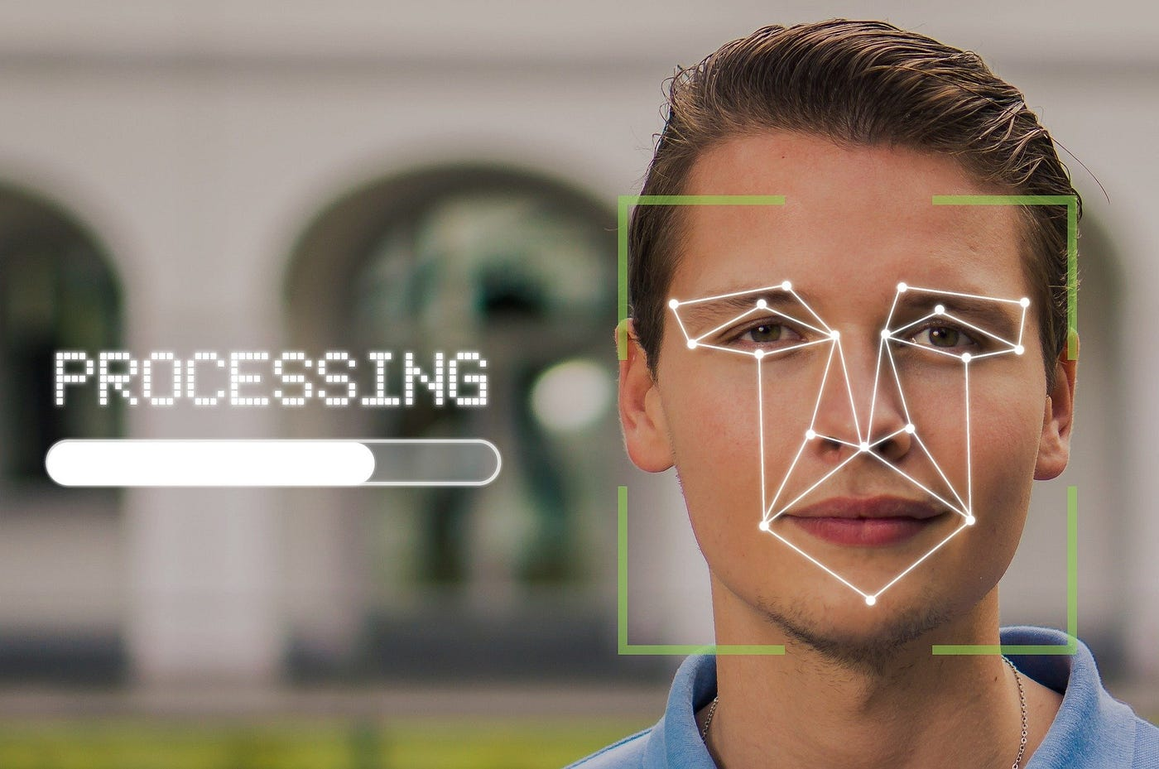
Preprocessing
In this phase, the different data modalities will be prepared and cleaned.
Frames normalization
Face cropping
Notes:
Video frames are to be uniformly sampled and resized to ensure a consistent structure for video input.
For enhanced precision in model training, faces will be extracted from the video footage.

Slide 16
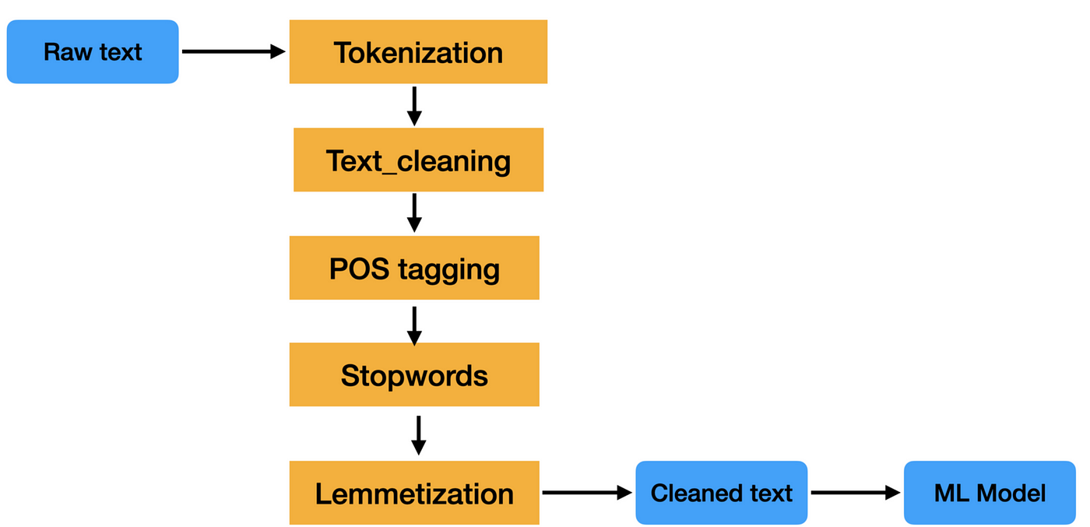
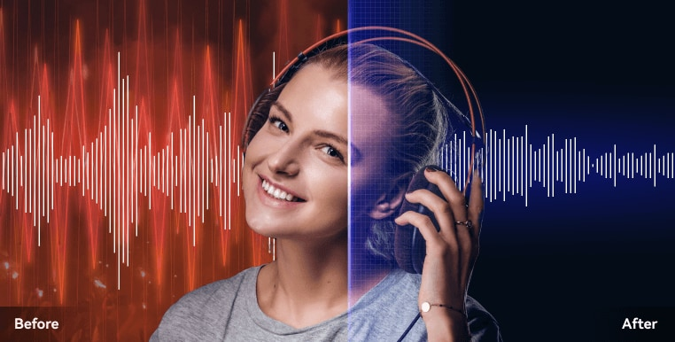
Preprocessing (cont.)
Text preprocessing
Audio noise reduction
Notes:
Audio signals will be processed to omit background noise and unwanted artifacts.
Natural Language Processing (NLP) techniques such as Tokenization, POS tagging and Lemmatization will be applied for the effective handling of text data.

Slide 17
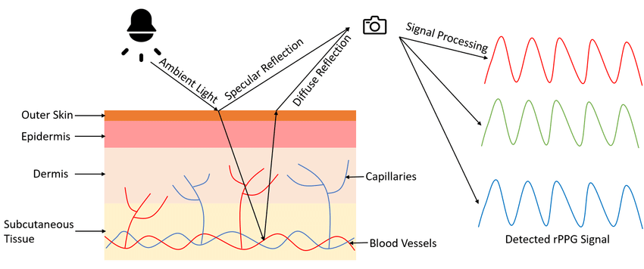
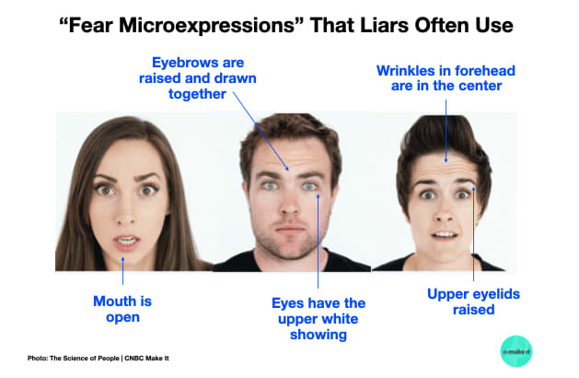
Feature engineering and extraction
A data-centric approach is applied here to get better features to train the models.
Remote Photoplethysmography
Behavioral signals
Notes:
Heart rate signals will be extracted from video footage using remote photoplethysmography (rPPG).
Behavioral signals such as blink rate and different hand movements will be extracted to assist in lies prediction.

Slide 18
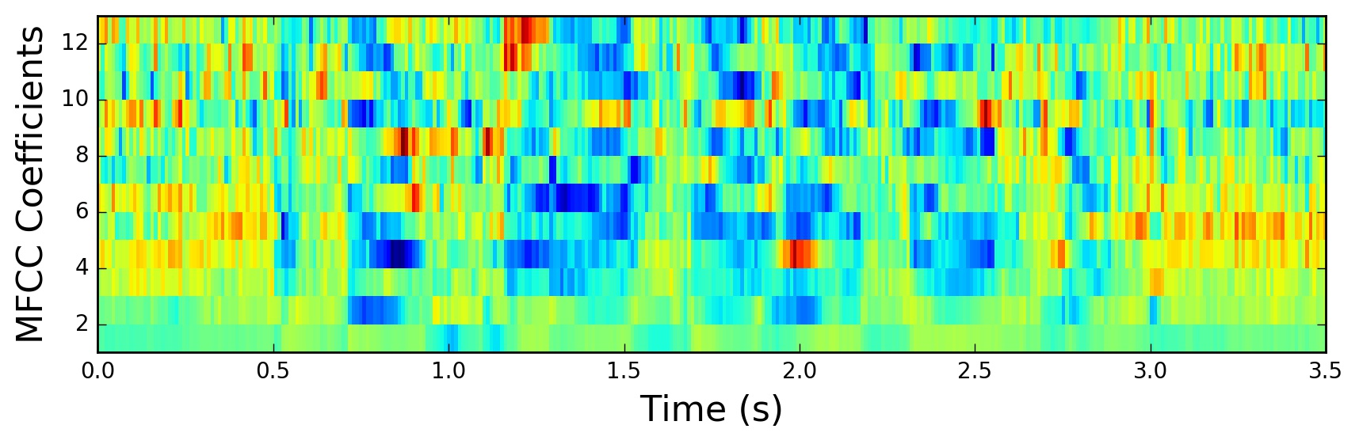
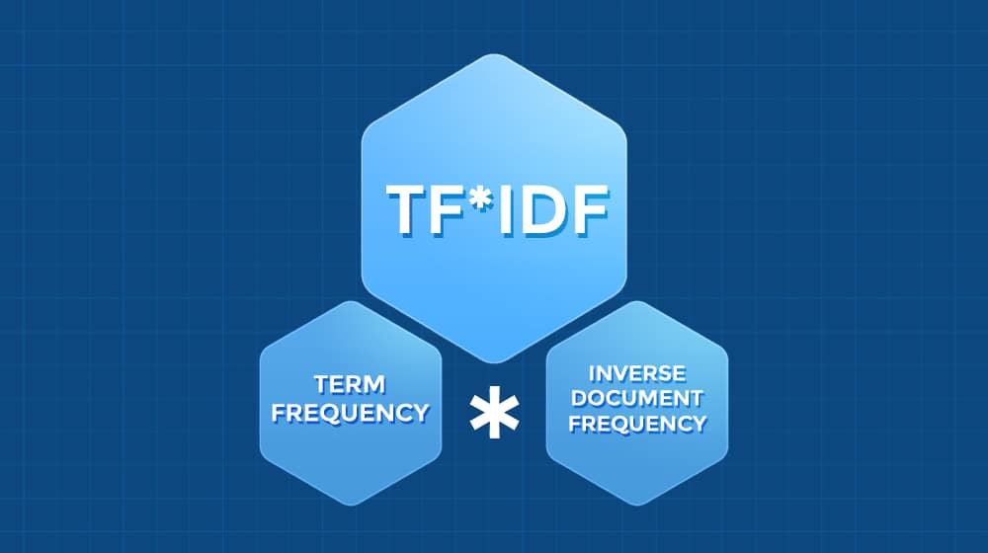
Feature engineering and extraction (cont.)
Mel-frequency cepstral coefficients
Text features
Notes:
Feature extraction of audio signals using techniques such as Mel-frequency cepstral coefficients (MFCCs).
Extracting features from processed text data using NLP techniques such as TF-IDF or Word embeddings.

Slide 19
Models training, testing and evaluation
Models will be trained for data classification and subsequently tested on new, unseen data to assess their generalization capabilities. Additionally, visualization tools and evaluation metrics will be used to analyze the results.
Classical Machine learning classifiers such as SVMs, Decision Trees and Logistic Regression.
Deep Learning approaches with neural networks like 2D and 3D CNNs and RNNs such as LSTMs.
Transfer Learning methodologies through fine tuning pre-trained models such as ResNet50 and InceptionV3.

Slide 20
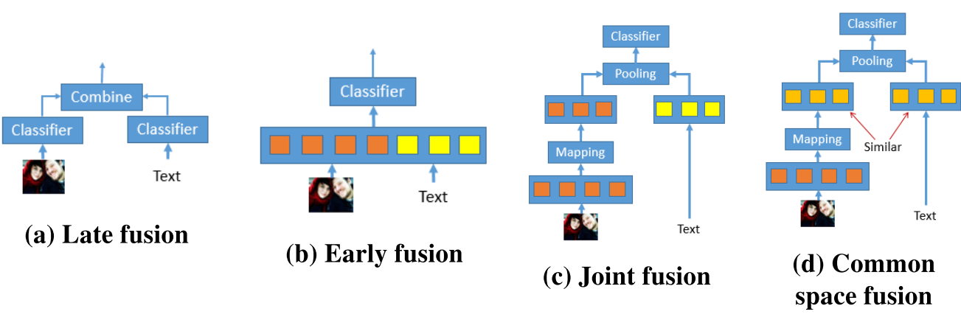
Multimodal data fusion
Multimodal data fusion is a process that involves integrating data from multiple modalities into one model that is more comprehensive and effective in making predictions.
Fusion methodologies
Notes:
Methods such as Early Fusion or Late Fusion will be utilized to create a model that is more capable than models that are trained on individual data modalities.
Other fusion methods like intermediate fusion will be tested to see if they yield better results.

Slide 21

Time Plan

Slide 22
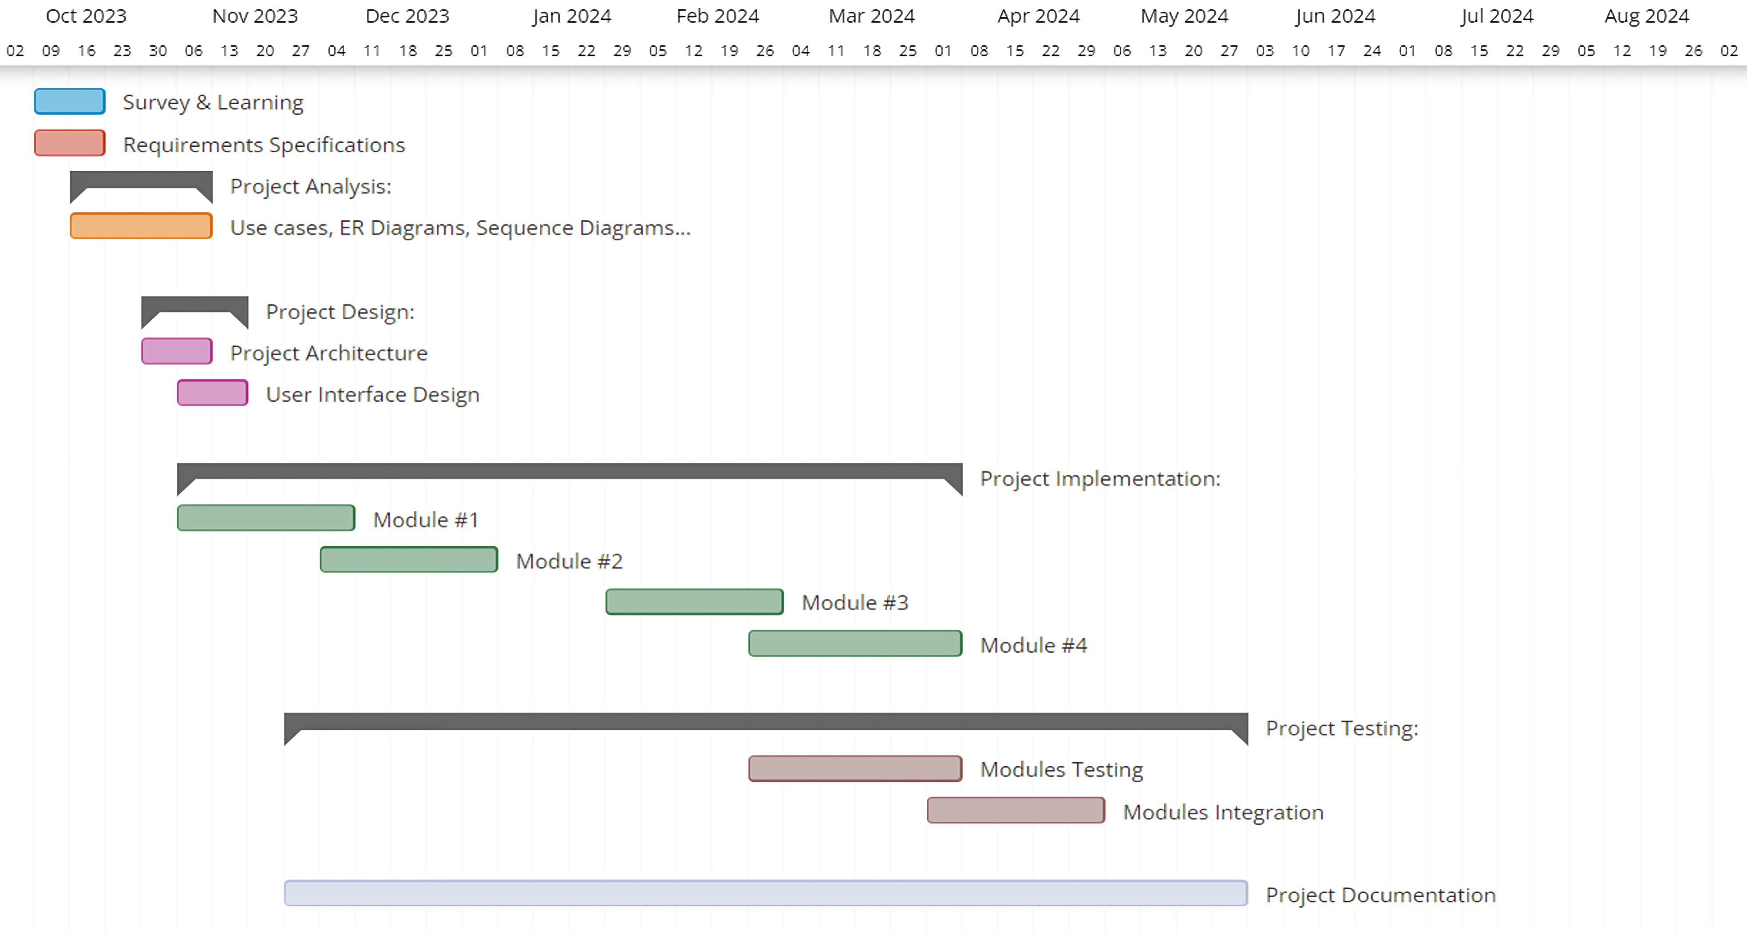
Notes:
Module #1: Preprocessing and preparing different data modalities (Audio, Text, Video)
Module #2: Features Engineering and extraction (rPPG, MFCCs, behavioral signals etc…)
Module #3: Models training, testing and evaluation
Module #4: Multimodal data fusion

Slide 23

Challenges
Lack of high-quality datasets that are related to the topic of deception detection.
Video data in most datasets have different durations and resolutions which adds more preprocessing overhead.
Accurately capturing a heart rate signal through remote photoplethysmography (rPPG) can be particularly difficult, especially when dealing with videos of poor quality or inadequate lighting conditions.

Slide 24
Challenges (cont.)
The models require substantial processing power and time to fit to the data.
Combining different modalities of data in one model or multiple models and having them collaborate is a challenging task and an open area of research to this very day.
Some datasets require special permissions to get access from the authors.

Slide 25









Tools
Notes:
Pandas
Numpy
Tensorflow
OpenCV
OS
Scikit-Learn
Py-Feat
NLTK
Django
React

Slide 26
References
Gallardo-Antolín, A. and Montero, J.M., 2021. Detecting deception from gaze and speech using a multimodal attention LSTM-based framework. Applied Sciences, 11(14), p.6393.
Soldner, F., Pérez-Rosas, V. and Mihalcea, R., 2019, June. Box of lies: Multimodal deception detection in dialogues. In Proceedings of the 2019 Conference of the North American Chapter of the Association for Computational Linguistics: Human Language Technologies, Volume 1 (Long and Short Papers) (pp. 1768-1777).
Gupta, V., Agarwal, M., Arora, M., Chakraborty, T., Singh, R. and Vatsa, M., 2019. Bag-of-lies: A multimodal dataset for deception detection. In Proceedings of the IEEE/CVF Conference on Computer Vision and Pattern Recognition Workshops (pp. 0-0).
Rill-García, R., Jair Escalante, H., Villasenor-Pineda, L. and Reyes-Meza, V., 2019. High-level features for multimodal deception detection in videos. In Proceedings of the IEEE/CVF Conference on Computer Vision and Pattern Recognition Workshops (pp. 0-0).
FCIS ASU July 2022: Documentation - Google Docs

Slide 27
References (cont.)
Bareeda, EP Fathima, BS Shajee Mohan, and KV Ahammed Muneer. "Lie detection using speech processing techniques." Journal of Physics: Conference Series. Vol. 1921. No. 1. IOP Publishing, 2021.
Ni, A., Azarang, A. and Kehtarnavaz, N., 2021. A review of deep learning-based contactless heart rate measurement methods. Sensors, 21(11), p.3719.
Martinez-Delgado, G.H., Correa-Balan, A.J., May-Chan, J.A., Parra-Elizondo, C.E., Guzman-Rangel, L.A. and Martinez-Torteya, A., 2022. Measuring heart rate variability using facial video. Sensors, 22(13), p.4690.
Yu, Z., Peng, W., Li, X., Hong, X. and Zhao, G., 2019. Remote heart rate measurement from highly compressed facial videos: an end-to-end deep learning solution with video enhancement. In Proceedings of the IEEE/CVF International Conference on Computer Vision (pp. 151-160).
Zhan, Q., Wang, W. and de Haan, G., 2020. Analysis of CNN-based remote-PPG to understand limitations and sensitivities. Biomedical optics express, 11(3), pp.1268-1283.

Slide 28


